Slide 1
Resp Support in year 3 (choice=Decannulated) of Tracheostomy Resource Utilization Study

Slide 2
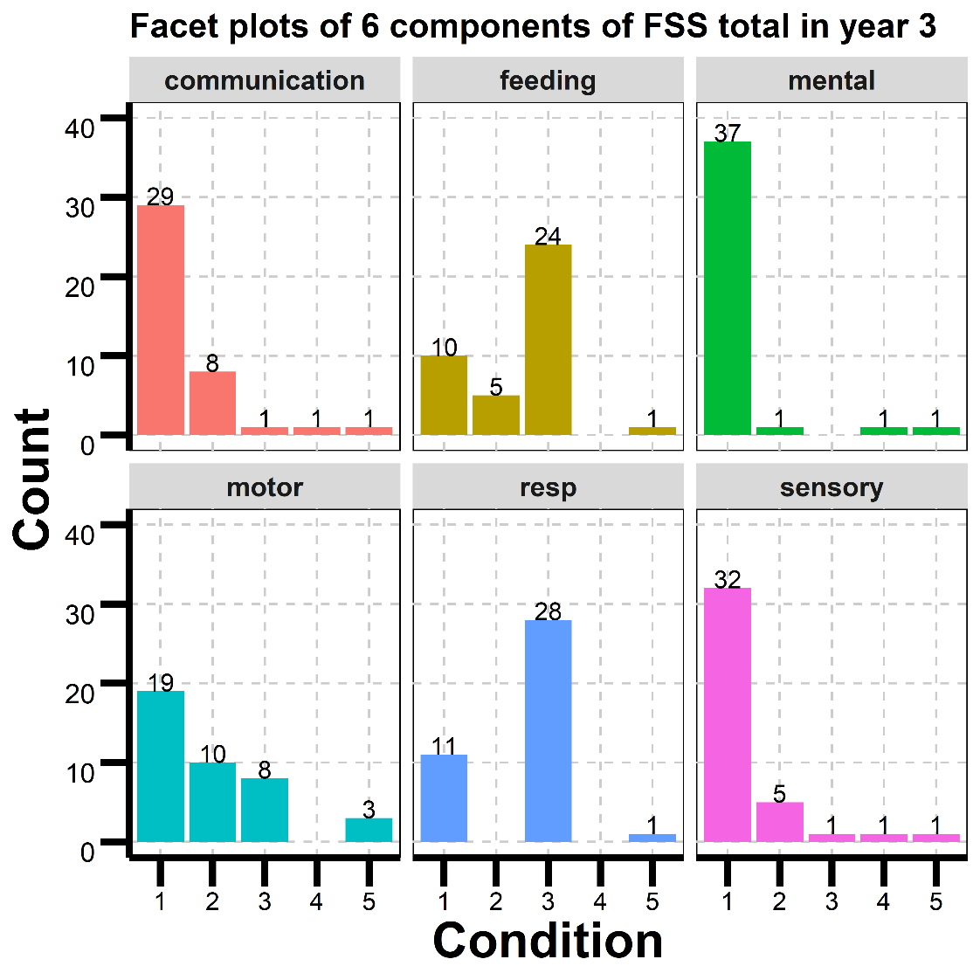
Bar plots of 6 components of FSS total in year 3
Condition: 1: Normal; 2: Mild; 3: Moderate; 4: Severe; 5: Very severe dysfunction
40 patients in the plot. 13 missing in the 6 components

Slide 3
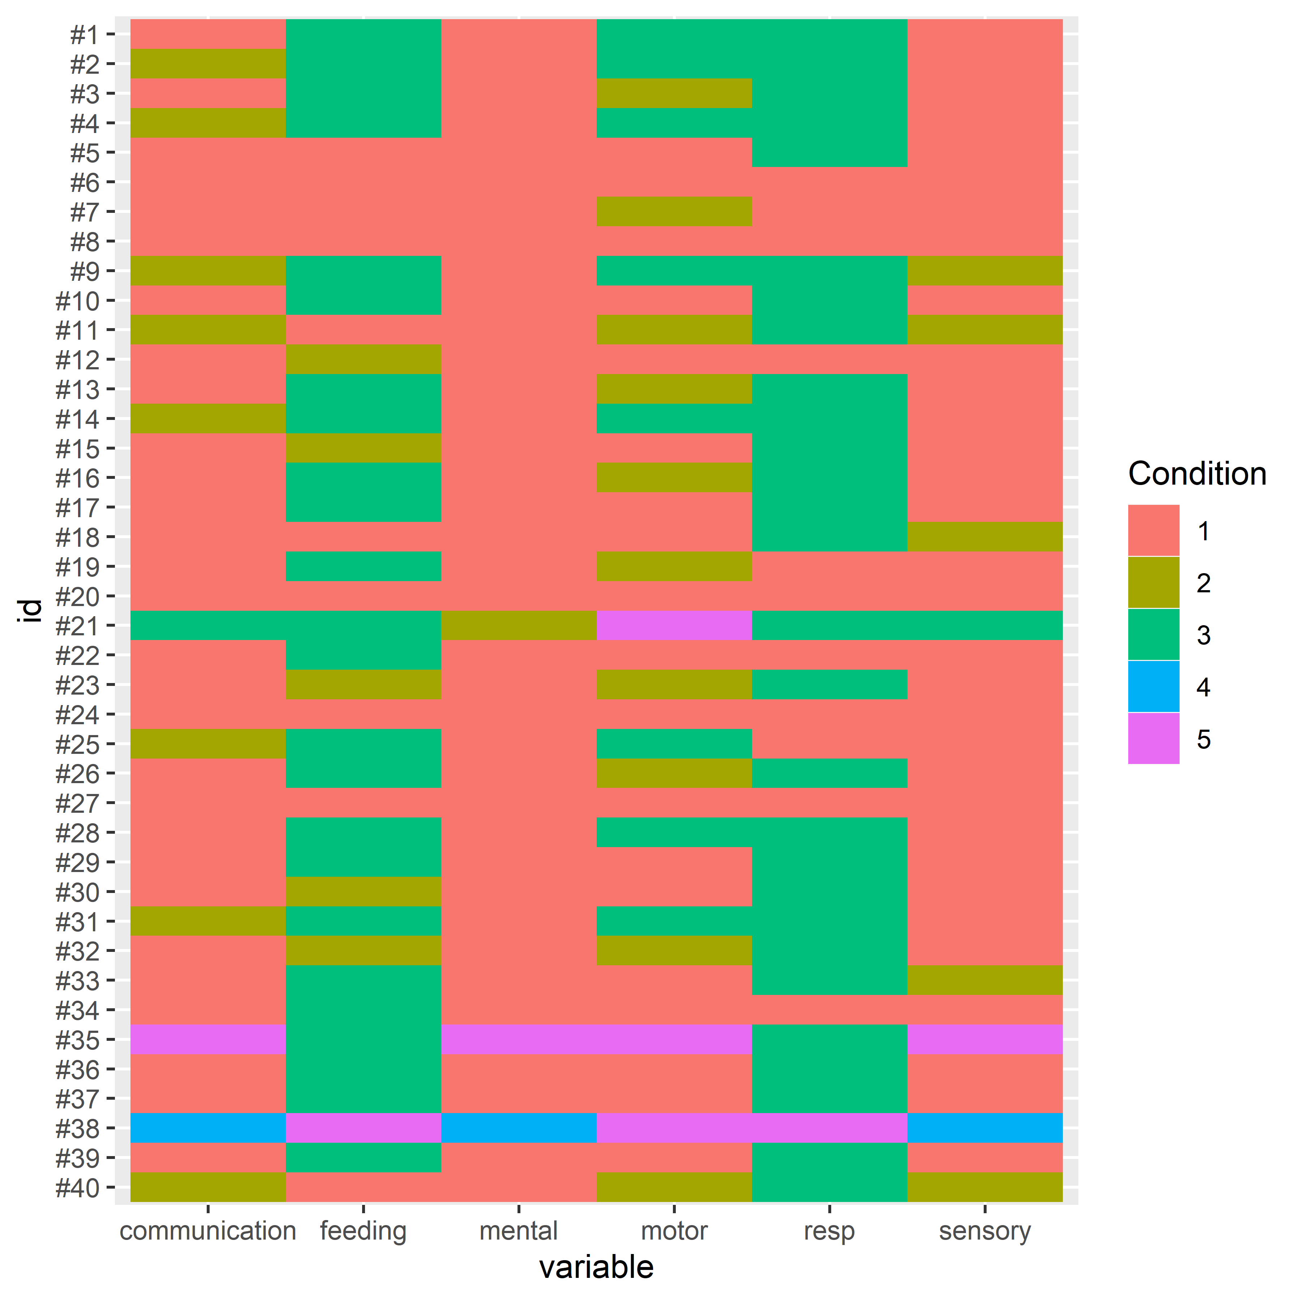
Heatmap-like plot of 6 components
Condition:
1: Normal
2: Mild
3: Moderate
4: Severe
5: Very severe dysfunction
For communication, mental and sensory, most of the patients have a normal condition. For feeding and resp, more than half of them are moderate.

Slide 4
1. Logistic regression for all 6 components
The outcome is Resp Support at three year (choice=Decannulated) and covariates are 6 components of FSS total.
For each component, classified the condition into two groups: normal(=1) and other(=0).
The output shows that none of the variables are significant.

Slide 5
2. Logistic regression for one component: MOTOR; FEEDING
The outcome is Resp Support at three year (choice=Decannulated) and the covariate is one of the 6 components of FSS total.
MOTOR
FEEDING
Going to Normal from other categories in MOTOR, the odds of checked in the outcome (versus unchecked) increase by a factor of exp(1.473)=4.36.
Going to Normal from other categories in FEEDING, the odds of checked in the outcome (versus unchecked) increase by a factor of exp(2.015)=7.50.
Component | Coefficients | Confidence interval | P-value
motor | 1.473 | (-0.051, 2.998) | 0.058
Component | Coefficients | Confidence interval | P-value
feeding | 2.015 | (0.4267, 3.603) | 0.013

Slide 6
3. Stepwise of logistic regression in terms of AIC
step1: mental + sensory + communication + motor + feeding + resp
AIC=14
step2: sensory + communication + motor + feeding + resp
AIC=12
step3: communication + motor + feeding + resp
AIC=10
step4: motor + feeding + resp
AIC=8
step5: feeding + resp
AIC=6
step6: resp
AIC=4

Slide 7
4. Comparison between component resp and the outcome
3 | 3 | 5 | 3 | 3 | 3 | 1 | 3 | 3 | 3 | 3 | 3 | 3 | 1 | 3 | 1 | 1 | 3 | 1 | 3 | 1 | 1 | 3 | 3 | 3 | 3 | 3 | 3 | 1 | 3 | 3 | 3 | 1 | 1 | 1 | 3 | 3 | 3 | 3 | 3
0 | 0 | 0 | 0 | 0 | 0 | 1 | 0 | 0 | 0 | 0 | 0 | 0 | 1 | 0 | 1 | 1 | 0 | 1 | 0 | 1 | 1 | 0 | 0 | 0 | 0 | 0 | 0 | 1 | 0 | 0 | 0 | 1 | 1 | 1 | 0 | 0 | 0 | 0 | 0
First row: RESPIRATORY STATUS; second row: respsupports_Decan
If RESPIRATORY STATUS is normal, respsupports_Decan is checked; Otherwise, it’s unchecked.

Slide 8
5. Stepwise of logistic regression without resp in terms of AIC
step1: mental + sensory + communication + motor + feeding
AIC=42.28
step2: sensory + communication + motor + feeding
AIC=40.28
step3: sensory + motor + feeding
AIC=38.37
step4: sensory + feeding
AIC=36.76
sensory is insignificant

Slide 9
Logistic regression for sensory + feeding
The outcome is Resp Support at three year (choice=Decannulated) and the covariate are sensory and feeding.
Going to Normal from other categories in sensory, the odds of checked in the outcome (versus unchecked) increase by a factor of exp(20.07)=520343641.
Going to Normal from other categories in FEEDING, the odds of checked in the outcome (versus unchecked) increase by a factor of exp(3.178)=24.
Component | Coefficients | P-value
sensory | 20.070 | 0.995
feeding | 3.178 | 0.0076

Slide 10
Conclusion
For the 40 patients in the dataset, if RESPIRATORY STATUS is normal, respsupports_Decan is checked; otherwise, it’s unchecked.
To quantify the odds of respsupports_Decan being checked, I would use the logistic regression for one component: FEEDING.
Going to Normal from other categories in FEEDING, the odds of checked in the outcome (versus unchecked) increase by a factor of exp(2.015)=7.50.

Slide 11
Logistic regression for all 6 components
For each component, classified the condition into two groups: normal(=1) and other(=0).
Coefficients: | Estimate | Std. Error | z value | Pr(>|z|)
(Intercept) | -2.657e+01 | 2.056e+05 | 0 | 1
mental1 | 4.265e-12 | 2.824e+05 | 0 | 1
sensory1 | -3.186e-12 | 2.127e+05 | 0 | 1
communication1 | -1.606e-12 | 1.829e+05 | 0 | 1
motor1 | 1.289e-12 | 1.459e+05 | 0 | 1
feeding1 | -6.957e-12 | 1.633e+05 | 0 | 1
resp1 | 5.313e+01 | 1.570e+05 | 0 | 1

Slide 12
Logistic regression for one component: MOTOR; FEEDING
MOTOR
FEEDING
Coefficients: | Estimate | Std. Error | z value | Pr(>|z|)
(Intercept) | -1.7918 | 0.6236 | -2.873 | 0.00406
motor1 | 1.4733 | 0.7777 | 1.894 | 0.05816
Coefficients: | Estimate | Std. Error | z value | Pr(>|z|)
(Intercept) | -1.6094 | 0.4899 | -3.285 | 0.00102
feeding1 | 2.0149 | 0.8103 | 2.486 | 0.01290

Slide 13
FSS at 3-year to predict decannulation at 3-year
 | adjusted log(odds) | P value | unadjusted log(odds) | P value
mental | -26.6 | 1 | 16.7 (-4460.1 4493.5) | 0.99
sensory | 0 | 1 | 17.9(-4502.0 4537.8) | 0.99
communication | 0 | 1 | 1.7(-0.5, 3.9) | 0.14
motor | 0 | 1 | 1.5(0, 3.0) | 0.06
feeding | 0 | 1 | 2.0 (0.43, 3.6) | 0.01
resp | 0 | 1 | 53.1(-247110.2 247216.5) | 1

Slide 14
FSS at 1-year to predict decannulation at 3-year
 | adjusted log(odds) | P value | unadjusted log(odds) | P value
mental | 17.0(-5645.6, 5679.5) | 0.995 | 17.7 (-3672.8, 3708.1) | 0.99
sensory | 1.3(-1.0,3.6) | 0.28 | 2.1(0,4.3) | 0.05
communication | 0.5(-1.1, 2.1) | 0.53 | 1.5(0,2.9) | 0.05
motor | -0.1(-1.6, 1.4) | 0.87 | 0.8(-0.6, 2.1) | 0.27
feeding | 0.3(-1.3, 1.9) | 0.70 | 1.0(-0.5, 2.4) | 0.20
resp | 16.5(-7733.8 7766.9) | 0.997 | 16.4(-3451.2, 3484.1) | 0.99
Going from other categories to normal in sensory, the odds of checked in the outcome (versus unchecked) increase by a factor of exp(2.1)=8.2.
Going from other categories to normal in communication, the odds of checked in the outcome (versus unchecked) increase by a factor of exp(1.5)=4.5.

Slide 15
FSS on discharge to predict decannulation at 3-year
 | adjusted log(odds) | P value | unadjusted log(odds) | P value
mental | 20.4(-7757.4, 7798.3) | 0.996 | 2.7 (0.5, 4.8) | 0.014
sensory | -18.7(-7796.5, 7759.1) | 0.996 | 1.5(-0.14, 3.15) | 0.07
communication | -0.29(-2.2, 1.6) | 0.76 | 0.6(-0.9,2.2) | 0.42
motor | 1.04(-0.8, 2.9) | 0.27 | 1.4(0, 2.8) | 0.055
feeding | -20.5(-24554.4, 24513.4) | 0.999 | -15.3(-3340.8, 3310.3) | 0.99
resp | 36.6(-11907.4, 11980.7) | 0.995 | 17.4(-4502.4, 4537.3) | 0.994
Going from other categories to normal in sensory, the odds of checked in the outcome (versus unchecked) increase by a factor of exp(1.5)=4.5.
Going from other categories to normal in motor, the odds of checked in the outcome (versus unchecked) increase by a factor of exp(1.4)=4.05.

